Slide 1
Life after Death
What Do We Know About The Resurrection?
Barry G. Johnson, Sr. - Sunday, January 21, 2023

Slide 2
What Do We Know About The Resurrection?
INTRODUCTION
"Second Coming" of our Lord will usher in a series of wonderful events…
"The Resurrection of the Dead"
Notes:
INTRODUCTION
1. As noted in the previous study, the "Second Coming" of our Lord will usher in a series of wonderful events...
a. The resurrection of the dead
b. Deliverance of the kingdom to the Father
c. The day of judgment
d. The new heavens and new earth
2. In this study, we shall concentrate our attention to just one of these events: "the resurrection of the dead"
a. As with many other things pertaining to "Life After Death", there can be a great deal of speculation about the resurrection
b. But what can we KNOW about the resurrection?
c. I.e., what has been clearly revealed in the Scriptures about this subject, that can give the Christian assurance and hope for the future?
[First of all, we can know...]

Slide 3
THE "FACT" OF THE RESURRECTION
What Do We Know About The Resurrection?
JESUS TAUGHT THERE WILL BE A RESURRECTION…
Jn 5:28-29
HIS APOSTLES PROCLAIMED A RESURRECTION FROM THE DEAD…
Ac 4:1-2
Ac 23:6; 24:15
1Co 15:12-23
1Th 4:16-18
Notes:
I. THE "FACT" OF THE RESURRECTION
A. JESUS TAUGHT THERE WILL BE A RESURRECTION...
1. A time is coming in which both those good and evil will come forth from the grave - Jn 5:28-29
2. Jesus assures those who believe in Him will be raised at "the last day" - Jn 6:39-40,44,54
B. HIS APOSTLES PROCLAIMED A RESURRECTION FROM THE DEAD...
1. Peter and John "preached in Jesus the resurrection from the dead" - Ac 4:1-2
2. In his defenses before the Sanhedrin and Felix, Paul confessed his hope in the resurrection - Ac 23:6; 24:15
3. To the church at Corinth, Paul asserted the necessity of the resurrection - 1Co 15:12-23
4. To the church at Thessalonica, he taught the doctrine of the resurrection as a source of comfort - 1Th 4:16-18
[Unless one questions the authority of Christ and His apostles, the "fact" of the resurrection is undeniable.
But how can such a thing happen? It helps to remember...]

Slide 4
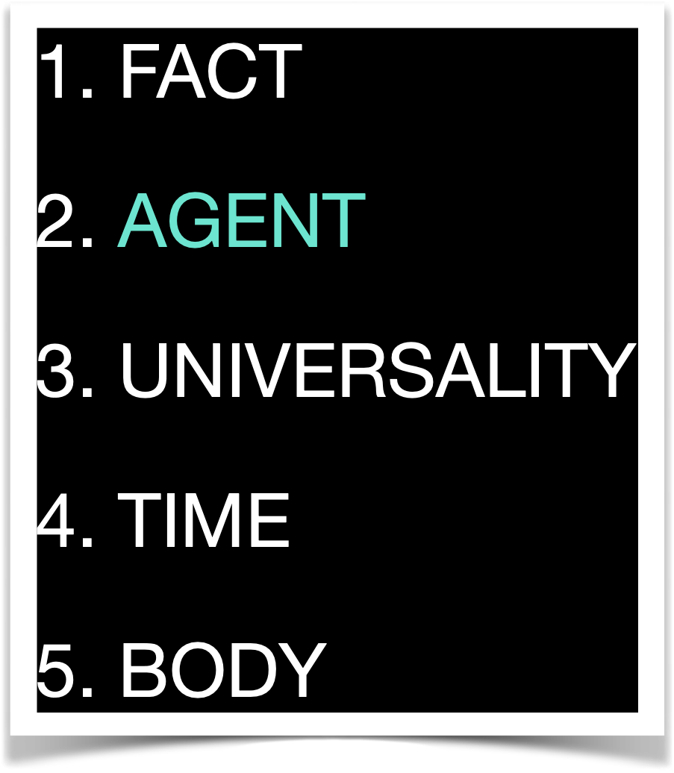
THE “AGENT" OF THE RESURRECTION
What Do We Know About The Resurrection?
CHRIST ATTRIBUTED IT TO "THE POWER OF GOD”...
Mt 22:29
Lk 1:37
PAUL ALSO EMPHASIZED "THE POWER OF GOD”...
1Co 6:14
2Co 4:14
Notes:
II. THE "AGENT" OF THE RESURRECTION
A. CHRIST ATTRIBUTED IT TO "THE POWER OF GOD"...
1. As He reminded the Sadducees, who denied the resurrection - Mt 22:29
2. And of course, "with God nothing will be impossible" - cf. Lk 1:37
B. PAUL ALSO EMPHASIZED "THE POWER OF GOD"...
1. The same power that raised Jesus from the dead - 1Co 6:14
2. He who can raise Jesus from the dead can certainly raise us up at the last day - 2Co 4:14
[While it may be difficult for us to comprehend "how" the dead can be raised, it is not difficult for God to do it (unless "your" God is too small)!
Another question to be addressed concerning the resurrection pertains to "who" will be raised. Therefore we note...]

Slide 5
THE “UNIVERSALITY" OF THE RESURRECTION
What Do We Know About The Resurrection?
TAUGHT BY JESUS
Jn 5:28-29
PAUL TAUGHT ALL WOULD BE RAISED…
Ac 24:15
1Co 15:21-22
Notes:
III. THE "UNIVERSALITY" OF THE RESURRECTION
A. AS TAUGHT BY JESUS - Jn 5:28-29
1. ”ALL who are in the graves will...come forth"
2. Both "those who have done good" and "those who have done evil"
a. One to experience a "resurrection of life"
b. The other a "resurrection of condemnation"
B. PAUL TAUGHT ALL WOULD BE RAISED...
1. ”both of the just and the unjust" - Ac 24:15
2. ”for as in Adam all die, even so in Christ all shall be made alive" - 1Co 15:21-22
[While there may be a difference in the nature of the resurrected bodies experienced (see later under the comments on "the body of the resurrection"), in some way EVERYONE will be raised from the dead!
What about the timing of the resurrection?]

Slide 6
THE “TIME" OF THE RESURRECTION
What Do We Know About The Resurrection?
AT THE "LAST DAY", WHEN THE LORD COMES AGAIN
Jn 6:39-40,44,54
1Co 15:22-26
1Co 15:52
WHAT ABOUT THE DOCTRINE OF SEPARATE RESURRECTIONS?
Dan 12:2; Jn 5:28-29; Ac 24:14-15; Re 20:11-15
Jn 6:39-40,44,54
1Th 4:13-16
Re 20:4-6; Re 2:26-27; 3:21
Notes:
IV. THE "TIME" OF THE RESURRECTION
A. AT THE "LAST DAY", WHEN THE LORD COMES AGAIN...
1. Jesus spoke again and again of raising the dead at "the last day" - Jn 6:39-40,44,54
2. Paul wrote of it occurring when Jesus comes again, to deliver the kingdom to the Father, having destroyed the last enemy, death itself - 1Co 15:22-26
3. He later says that it will occur at "the last trumpet" - 1Co 15:52
B. WHAT ABOUT THE DOCTRINE OF SEPARATE RESURRECTIONS?
1. The "premillennialists" (and perhaps others) teach that there will be more than just one resurrection
a. E.g., all premillennialists teach at least two resurrections:
1) The resurrection of believers at the BEGINNING of the millennium
2) The resurrection of unbelievers at the END of the millennium
b. Dispensational premillennialists add even two more:
1) The resurrection of tribulation saints at the end of the seven-year tribulation
2) The resurrection of millennial saints at the end of the millennium
2. There are several reasons why the doctrine of several resurrections is found wanting...
a. The Bible presents the resurrection of believers and unbelievers as occurring together - Dan 12:2; Jn 5:28-29; Ac 24:14-15; Re 20:11-15
b. The Bible teaches that believers will be raised at "the last day", not several times (and therefore several days, years, or a millennium) before "the last day"! - Jn 6:39-40,44,54
c. Passages offered in support of several resurrections do not necessarily teach what premillennialists say they do
1) E.g., 1Th 4:13-16 concerns itself with the resurrection of the righteous, but that does not demand that the wicked are not being raised at the same time
2) E.g., Re 20:4-6 describes a resurrection of "souls", not bodies, and the reigning with Christ is likely to be occurring in heaven, not on earth - cf. Re 2:26-27; 3:21
[One more subject to be considered in this study, and that pertains to...]

Slide 7
THE “BODY" OF THE RESURRECTION
What Do We Know About The Resurrection?
THE RESURRECTION BODY OF THE RIGHTEOUS
1Co 15:35-55
Mt 22:29; 1Co 15:35-37
Sown in corruption, will be raised in incorruption! - 1Co 15:42
Sown in dishonor, will be raised in glory! - 1Co 15:43a
Sown in weakness, will be raised in power! - 1Co 15:43b
Sown as natural bodies, will be raised as spiritual bodies! - 1Co 15:44-49
1Co 15:50-55
Php 3:20-21
Notes:
IV. THE "BODY" OF THE RESURRECTION
A. THE RESURRECTION BODY OF THE RIGHTEOUS...
1. Will be our physical bodies, but gloriously changed and different! - 1Co 15:35-55
a. By the power of God (cf. Mt 22:29), our physical bodies will serve as the "kernel" from which comes incorruptible and immortal bodies in which to house our souls - 1Co 15:35-37
b. Our physical bodies...
1) Sown in corruption, will be raised in incorruption! - 1Co 15:42
2) Sown in dishonor, will be raised in glory! - 1Co 15:43a
3) Sown in weakness, will be raised in power! - 1Co 15:43b
4) Sown as natural bodies, will be raised as spiritual bodies! - 1Co 15:44-49
c. Even those who are alive at Christ's coming will undergo this "change", in which that which is corruptible and mortal will "put on" incorruption and immortality - 1Co 15:50-55
2. Will conformed to the glorious body of our Lord! - Php 3:20-21
a. That which is "lowly" will be transformed to be like that which "glorious"
b. How? "...according to the working by which He is able even to subdue all things to Himself"; i.e., by the power of God!
B. THE RESURRECTION BODY OF THE WICKED...
1. Very little is actually revealed, other than the wicked will indeed be raised from the dead
2. Though the Scriptures only apply the terms "incorruption" and "immortality" to the resurrection bodies of the righteous, most interpreters hold that the resurrection body of the wicked...
a. Is not subject again to death
b. Is capable of experiencing eternal suffering
3. There are some, however, who understand that the "second death" will be literal...
a. I.e., after the resurrection and judgment, the wicked will "die" again (a separation of resurrected "body" and spirit)
b. Not that the wicked will be annihilated, but that they will spend eternity as "disembodied spirits" in the lake of fire
c. This is not to be confused with those either don't believe in a resurrection of the wicked, or who believe the wicked will be annihilated
4. Since the Bible is relatively silent on this subject perhaps "...the best course seems to be simply leave the problem where it was left by the writers of the New Testament." (Ray Summers, The Life Beyond, p. 93)
CONCLUSION
1. There is probably much more about the resurrection that we would like to know
2. But certainly enough is revealed to motivate those who desire whatever God has prepared to love and obey Him!
Are you making it your aim to be ready for whatever God has prepared...?
So when this corruptible has put on incorruption, and this mortal has put on immortality, then shall be brought to pass the saying that is written: "Death is swallowed up in victory."
"O Death, where is your sting? O Hades, where is your victory?"
The sting of death is sin, and the strength of sin is the law.
But thanks be to God, who gives us the victory through our Lord Jesus Christ.
Therefore, my beloved brethren, be steadfast, immovable, always abounding in the work of the Lord, knowing that your labor is not in vain in the Lord. - 1Co 15:54-58

