Slide 2
RAISING UP THE CROSS
{
Death
Atonement
Justice
Salvation

Slide 3
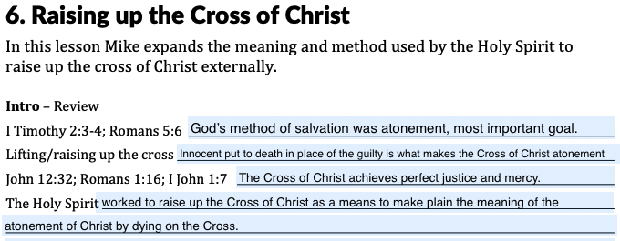
- I John 1:7
but if we walk in the Light as He Himself is in the Light, we have fellowship with one another, and the blood of Jesus His Son cleanses us from all sin.

Slide 4
Why Raise up the Cross?
Singular work of Holy Spirit in Old Testament and New Testament
Makes salvation available
Explains the plan of salvation

Slide 5
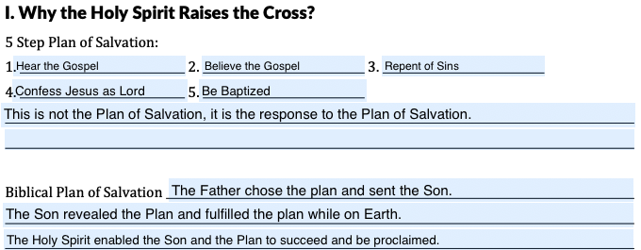
Church of Christ “Plan” of Salvation
Hear
Believe
Repent
Confess
Baptism
}
5 Step Plan of Salvation

Slide 6
Biblical Plan of Salvation
Father chooses vicarious atonement and sends Son to reveal and complete this plan.
The Holy Spirit enables the Son to fulfill the plan and empowers the Apostles to proclaim the gospel.
Hearing, believing, repenting, confessing and baptism are the response of faith to God’s plan.

Slide 7
- Acts 2:37-38
³⁷ Now when they heard this, they were pierced to the heart, and said to Peter and the rest of the apostles, “Brethren, what shall we do?” ³⁸ Peter said to them, “Repent, and each of you be baptized in the name of Jesus Christ for the forgiveness of your sins; and you will receive the gift of the Holy Spirit.

Slide 8
- Acts 2:39-41
³⁹ For the promise is for you and your children and for all who are far off, as many as the Lord our God will call to Himself.” ⁴⁰ And with many other words he solemnly testified and kept on exhorting them, saying, “Be saved from this perverse generation!” ⁴¹ So then, those who had received his word were baptized; and that day there were added about three thousand souls.

Slide 9
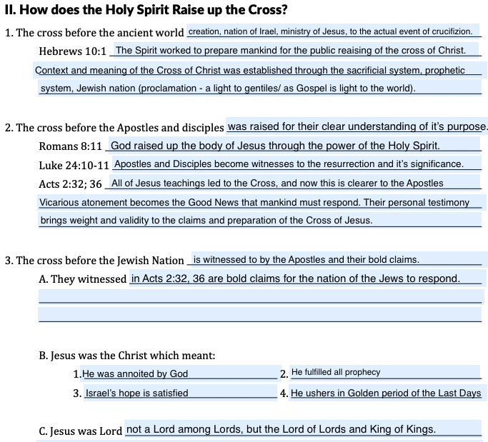
Raising up the Cross
Before the ancient world
Before the Apostles/Disciples
Before the Jewish Nation

Slide 10
- I Timothy 6:15-16
¹⁵ which He will bring about at the proper time—He who is the blessed and only Sovereign, the King of kings and Lord of lords, ¹⁶ who alone possesses immortality and dwells in unapproachable light, whom no man has seen or can see. To Him be honor and eternal dominion! Amen.

Slide 11
Baptism of the Holy Spirit
Baptism with the Holy Spirit

Slide 12
Is there such a thing as the baptism of the Holy Spirit?

Slide 13
- Ephesians 4:4-6
⁴ There is one body and one Spirit, just as also you were called in one hope of your calling; ⁵ one Lord, one faith, one baptism, ⁶ one God and Father of all who is over all and through all and in all.

Slide 14
- I Corinthians 12:12-13
¹² For even as the body is one and yet has many members, and all the members of the body, though they are many, are one body, so also is Christ. ¹³ For by one Spirit we were all baptized into one body, whether Jews or Greeks, whether slaves or free, and we were all made to drink of one Spirit.

Slide 15
WATER BAPTISM
{
John the Baptist
Jesus
Peter and Apostles
Paul
Brookfield Church of Christ

Slide 16
Matthew 28:18-20
Mark 16:16
John 3:5
Acts 2:38
Romans 6:3
Galatians 3:27
I Peter 3:21
Revelation 7:14
Acts 22:16

Slide 17
The Baptism of the Holy Spirit is Water Baptism.

Slide 18
Baptism with the Holy Spirit
A greater presence or interaction with Holy Spirit. For example:
Moses – Num. 11:17
Joshua – Num. 27:18
Samson – Ju. 13:25
Apostles – Acts 1:5
David – I Sam. 16:13
Isaiah – Isaiah 61:1
Jesus – Mark 1:10

Slide 19
- Acts 1:8
but you will receive power when the Holy Spirit has come upon you; and you shall be My witnesses both in Jerusalem, and in all Judea and Samaria, and even to the remotest part of the earth.”

Slide 20
COMING OF MESSIAH
{
Grace, mercy, forgiveness.
Pouring out of spirit on all.

Slide 21
- Isaiah 53:4-6
⁴ Surely our griefs He Himself bore, And our sorrows He carried; Yet we ourselves esteemed Him stricken, Smitten of God, and afflicted.
⁵ But He was pierced through for our transgressions, He was crushed for our iniquities; The chastening for our well-being fell upon Him, And by His scourging we are healed.
⁶ All of us like sheep have gone astray, Each of us has turned to his own way; But the Lord has caused the iniquity of us all To fall on Him.

Slide 22
¹⁷ ‘And it shall be in the last days,’ God says, ‘That I will pour forth of My Spirit on all mankind; And your sons and your daughters shall prophesy, And your young men shall see visions, And your old men shall dream dreams; ¹⁸ Even on My bondslaves, both men and women, I will in those days pour forth of My Spirit And they shall prophesy.
- Acts 2:17-18

Slide 23
- Acts 2:37-38
³⁷ Now when they heard this, they were pierced to the heart, and said to Peter and the rest of the apostles, “Brethren, what shall we do?” ³⁸ Peter said to them, “Repent, and each of you be baptized in the name of Jesus Christ for the forgiveness of your sins; and you will receive the gift of the Holy Spirit.

Slide 24
Holy Spirit
Baptism with the Holy Spirit = Empowered
Indwelling of the Holy Spirit = Sanctification

Slide 25
- Ephesians 1:13
In Him, you also, after listening to the message of truth, the gospel of your salvation—having also believed, you were sealed in Him with the Holy Spirit of promise,

Slide 26
Summary
Holy Spirit → Raises up the Cross of Christ

Slide 27
Summary
Holy Spirit raises up the cross
To the ancient world
To the Apostles
To the Jewish Nation

Slide 28
Summary
Baptism with the Holy Spirit is a generic term that can mean:
Empowering – Acts 1:8 – Apostles – Acts 10:44-45 – Cornelius
Indwelling – Acts 2:38 – Receiving H.S. – Rom. 8:9-12 – Sanctification Process

Slide 29
⁹ However, you are not in the flesh but in the Spirit, if indeed the Spirit of God dwells in you. But if anyone does not have the Spirit of Christ, he does not belong to Him. ¹⁰ If Christ is in you, though the body is dead because of sin, yet the spirit is alive because of righteousness.
- Romans 8:9-10

Slide 30
¹¹ But if the Spirit of Him who raised Jesus from the dead dwells in you, He who raised Christ Jesus from the dead will also give life to your mortal bodies through His Spirit who dwells in you. ¹² So then, brethren, we are under obligation, not to the flesh, to live according to the flesh.
- Romans 8:11-12

