Slide 1
Taught at: Schrader Lane Church of Christ 2023
7
One Plus One Equals Survival
Ecc. 4:9-12
Barry G. Johnson, Sr. - Facilitating

Slide 2
New Coming Soon: Ecclesiastes: A Striving After the Wind Wednesdays through November 8th On Zoom @ 6:15 p.m. Free PDF Book & Student Workbook available for download at www.BarrysBureau.com/Ecclesiastes.html Barry Johnson, Sr. - Facilitating

Slide 3
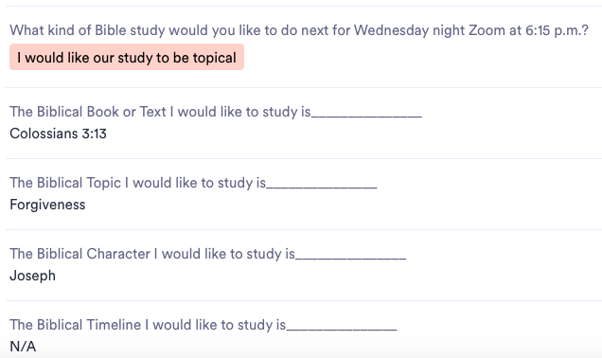
Colossians 3:13 (ESV)
13 bearing with one another and, if one has a complaint against another, forgiving each other; as the Lord has forgiven you, so you also must forgive.
JOSEPH, SON OF JACOB. The 11th son of the patriarch Jacob, and the principal character in the biblical narrative of Genesis 37–50.

Slide 4
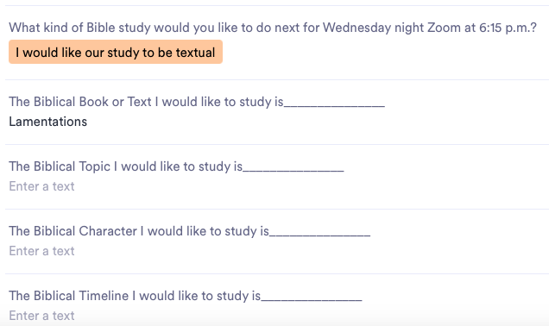
LAMENTATIONS, BOOK OF. Lamentations consists of a series of five poems on the destruction of Jerusalem in 586 b.c. The poems do not narrate in order the events of the fall of the city, but through a variety of speakers they give vivid short pictures of the horrors of the siege and its aftermath, reflect on the causes of the calamity, and appeal for mercy to the God who brought about the ruin of his own city and temple. In later Jewish liturgical practice, Lamentations was associated with the 9th of Ab, when various destructions of the state, the city, and the temple are commemorated, and this practice may go back to earliest exilic times (see Jer 41:5; Zech 7:3–5; 8:19).

Slide 5
Question: Solomon teaches the cure for loneliness is what? How does the Church address the struggle of loneliness in our lives?

Slide 6
Darrell Moore
Admittedly, I don’t hear many sermons on this topic. We do have ministries that address the needs of widows, widowers, and divorced and single members, not that they're the only members who may be dealing with loneliness. This is interesting. In the wake of our listening sessions, perhaps this is an additional service that the leaders need to address.

Slide 7
Valerie McClain
This question is difficult to answer because sometimes one may not know the struggle a person is going through. As believers in Christ Jesus, we are never alone. God is and will always be with us throughout eternity. Rom..14:7

Slide 8
Timothy McCleskey Does Ecclesiastes 4:9-12 teach against self-sufficiency?

Slide 9
It is lonely at the top.

Slide 10
The emotion felt when lonely is usually dictated by the cause of the separation.

Slide 11
Visiting the island of Loneliness is normal.

Slide 13
We know we have been on the island too long when we say: “Why don’t people love/help me?”

Slide 14
We know we have been on the island too long when we say: “If only other people realized how difficult things are for me?”

Slide 15
We know we have been on the island too long when we say: “Nobody cares. I’m all alone in this.”

Slide 16
We cannot enjoy life to the fullest as loners!

Slide 17
Two are better than one because they have a good return for their labor.
- Ecc. 4:9

Slide 18
For if either of them falls, the one will lift up his companion. But woe to the one who falls when there is not another to lift him up.
- Ecc. 4:10

Slide 19
Furthermore, if two lie down together they keep warm, but how can one be warm alone?
- Ecc. 4:11

Slide 20
And if one can overpower him who is alone, two can resist him.
- Ecc. 4:12a

Slide 21
A cord of three strands is not quickly torn apart.
- Ecc. 4:12a-b

Slide 22
Timothy McCleskey Does Ecclesiastes 4:9-12 teach against self-sufficiency?

Slide 23
The antidote to loneliness is companionship
Companions help calm the storms of life.

Slide 24
The antidote to loneliness is companionship
Companions reassure us when we are vulnerable or self-conscious.

Slide 25
The antidote to loneliness is
companionship
Companions take our part when others try to take us apart.

Slide 26
When it come to loneliness, one person plus a friend equals survival.

