Slide 1
Taught at: Schrader Lane Church of Christ 2023
3
The Pursuit of Meaning Through Work
Ecc. 2:12-26
Barry G. Johnson, Sr. - Facilitating

Slide 2
New Coming Soon: Ecclesiastes: A Striving After the Wind Wednesdays through November 8th On Zoom @ 6:15 p.m. Free PDF Book & Student Workbook available for download at www.BarrysBureau.com/Ecclesiastes.html Barry Johnson, Sr. - Facilitating
Notes:
We are reviewing the part of Solomon's journal where he describes his experiences and conclusions concerning the different lifestyles that he has examined.
The pursuit of pleasure has taught him that although enjoyable, pleasurable experiences cannot be accumulated in order to produce joy or satisfaction.
They are fleeting and have no lasting or transformative value.

Slide 3
Pleasure is pleasurable but also fleeting without lasting value.
Notes:
Next, he goes on to survey life lived wisely or foolishly (carefree, no thought for tomorrow) in order to see which is better.
After this, he considers the idea of work and makes notations of his findings along the way.
Let us first begin with Solomon's thoughts on a life of wisdom and folly.

Slide 4
So I turned to consider wisdom, madness and folly; for what will the man do who will come after the king except what has already been done? And I saw that wisdom excels folly as light excels darkness. The wise man’s eyes are in his head, but the fool walks in darkness.
- Ecc. 2:12-14a
Notes:
Verses 12-14a: Solomon remarks that he alone chooses which lifestyle he will live by (wise or foolish), no one dictates it to him.
He leads as king and others merely follow.
At first glance it seems that to live wisely is better.
The wise man thinks, avoids the pitfalls of life and thus demonstrates the superiority of this lifestyle.
The fool, on the other hand, is always in trouble, always dealing with self-inflicted problems because of his carelessness, foolishness, greed or pride.

Slide 5
And yet I know that one fate befalls them both. Then I said to myself, “As is the fate of the fool, it will also befall me. Why then have I been extremely wise?” So I said to myself, “This too is vanity.”
- Ecc. 2:14b-15
Notes:
Verses 14b-15: Once he goes beyond this thought however, he realizes that death will be the end of both the fool and the wise man.
There is, therefore, no real advantage to living wisely because living this way cannot overcome the final destiny of all men, death.
Solomon reasons that wisdom and its practice or lack of practice is also vanity because it cannot protect you against death.

Slide 6
For there is no lasting remembrance of the wise man as with the fool, inasmuch as in the coming days all will be forgotten. And how the wise man and the fool alike die! So I hated life, for the work which had been done under the sun was grievous to me; because everything is futility and striving after wind.
- Ecc. 2:16-17
Notes:
Verse 16-17: To make matters worse, not only do both the wise and foolish die, but they are also both forgotten.
Given enough time, both are swallowed up in history and their lives and memory are extinguished.
This realization drives the author to despair.

Slide 7
Thus I hated all the fruit of my labor for which I had labored under the sun, for I must leave it to the man who will come after me.
- Ecc. 2:18
Notes:
The pursuit of meaning through work - 2:18 - 3:22
Solomon considers not only work in this section but the result of work and the context in which a man's life is played out - time.
Both chapters 2 and 3 conclude with some insights about what he has learned thus far.
1. The fruit of one's labor - verses 18-25
2:18: The realization that the wise and fool both die turns his attention to the work that both do.
If they both die, then the fruit of their labor will be left behind (no matter how well they do it).

Slide 8
And who knows whether he will be a wise man or a fool? Yet he will have control over all the fruit of my labor for which I have labored by acting wisely under the sun. This too is vanity.
- Ecc. 2:19
Notes:
2:19: Who knows if a wise man's labor will not be left in the hands of a fool after he is gone.
What, therefore, is the purpose of wise, meaningful and productive work?

Slide 9
Therefore I completely despaired of all the fruit of my labor for which I had labored under the sun. When there is a man who has labored with wisdom, knowledge and skill, then he gives his legacy to one who has not labored with them. This too is vanity and a great evil.
- Ecc. 2:20-21
Notes:
2:20-21: Another despairing thought is the situation where a man works hard in order to accumulate wealth only for it to be left to one who did not earn the profit.
Many have left their hard-earned fortunes in the hands of children who never work and whose only activity is to spend what their fathers have accumulated.

Slide 11
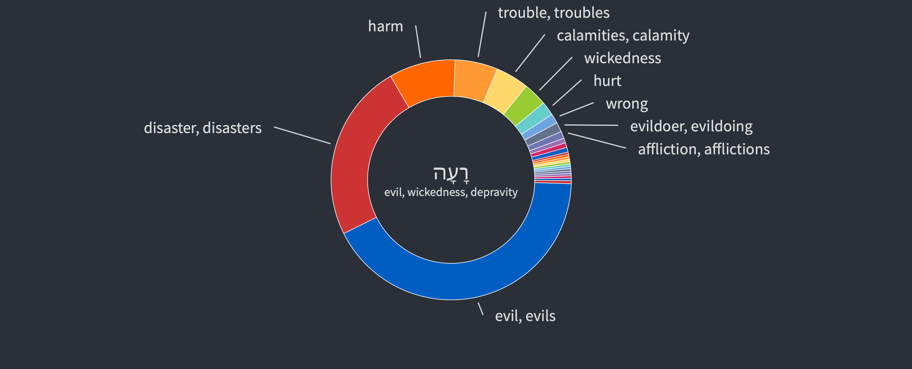
Evil – 313x’s in (ESV)
evil, wickedness, depravity; misfortune, disaster

Slide 12
For what does a man get in all his labor and in his striving with which he labors under the sun? Because all his days his task is painful and grievous; even at night his mind does not rest. This too is vanity.
- Ecc. 2:22-23
Notes:
2:22-23: Even while he is alive and active in work (which is in itself hard), he worries at night about the work itself (stress) and the concerns that he has already mentioned.
Solomon knew firsthand about his own heir's propensity for foolishness and waste.
Rehoboam, Solomon's son, foolishly plunged Israel into civil war in the very first year of his reign and had to strip the temple of its gold to pay off the Egyptian army to protect him from the threat of foreign invasion brought about by the turmoil that he had caused.
At this point Solomon draws the first of a series of insights that he has gleaned from his observation of "work" and "time."

Slide 13
There is nothing better for a man than to eat and drink and tell himself that his labor is good. This also I have seen that it is from the hand of God. For who can eat and who can have enjoyment without Him?
- Ecc. 2:24-25
Notes:
Verses 24-25: The ability to experience joy (glad satisfaction) is not related to what we do no matter how hard we work or how great our achievements.
The experiences of joy, peace, and satisfaction are gifts we receive from God.
Whatever satisfaction we feel from what we do is partial or fleeting.
The peace, satisfaction and joy we feel as gifts from God, however, are there because we have a relationship with Him.

Slide 14
Observation
The ability to experience joy is not related to what we do.
Notes:
Joy encompasses the good and the bad. It has the ability to to draw energy outside of circumstances.
Happiness is different because it depends on the circumstances and beholden to what is happening.

Slide 15
We experience the relationship of joy in several ways:
- Salvation
- Hope
- Insight
- Love
Notes:
We experience this relationship and joy in several ways:
Salvation - the joy, relief and gratitude felt in knowing that we are forgiven for our sins.
Hope - the confidence we have in facing trials, persecution and death as believers.
Insight - The pure joy of having our eyes opened to the truth about life revealed through God's word.
Love - The peace and joy that come from acting out of love - serving, bearing each other's burdens, forgiving, sharing and other actions motivated by the Spirit and not the flesh.

Slide 16
Relationship with Christ ↓ Satisfaction ↓ Love, Joy, Peace
Notes:
The "experience" of our relationship with God through Christ in whatever form it takes is the thing that produces the joy, satisfaction, peace and confidence that all of us so desperately want,
and so many mistakenly seek through the pursuit of sensual pleasure or career success.
The satisfaction we search for is only possible in an "experienced" relationship with Christ, which results in an awareness of love, joy, peace and other blessings in our lives.
This experience is a free gift from God to us through Christ.
The mistake is thinking that we work at a variety of things and then draw on these outward things in order to create an inward experience from the outside in.
We delude ourselves into thinking that if we do what we do faster, better, more efficiently and profitably
- this will create the feeling of satisfaction, peace and joy.
In other words, if we improve the outside, it will necessarily improve the inside.
This idea is partly true because when you improve the outside,
the improvement that does take place on the inside (joy, peace, etc.) is only temporary because new problems and failure to remember old lessons will require constant monitoring, tinkering and improving.
For example, the reason marketers release a new and improved "Tide" detergent every few years or so is not because this soap product does not work.
They come up with a new package and promise because consumers get tired of the old Tide and want something new.
Marketing consultants exist because of this weakness in people (the temporariness of satisfaction).

Slide 17
Solomon is saying that satisfaction, joy and peace work from the inside out!
Notes:
I believe Solomon is saying that for satisfaction, joy and peace to be lasting, it has to be developed from the inside out.
It is the experience of Christ, freely given and experienced inwardly that radiates outwardly and thus enables us to enjoy the externals
(the beauty of creation, the laughter of a child, the sound of music, even the old-formula Tide).
For example, the joy in my heart because of Christ makes me hear and enjoy the wind blowing in the trees while praising God who sends the wind and created the trees.
Otherwise, it would simply be noise, molecules, sound waves, "endless repetition without meaning" as Solomon says.
My inside joy and peace color everything I see, touch and experience with either appreciation or hope.
I appreciate the good, hope for future good and pray for the bad.
The externals (whether work or anything else) are suffused with joy and satisfaction from the inside.
I work on the inside to make lasting improvements on the outside.

Slide 18
For to a person who is good in His sight He has given wisdom and knowledge and joy, while to the sinner He has given the task of gathering and collecting so that he may give to one who is good in God’s sight. This too is vanity and striving after wind.
- Ecc. 2:26
Notes:
2:26 - The second insight that Solomon shares at this point is:
Those who are right with God derive benefit from all that they do, not only from what they succeed at.
This does not mean that only Christians succeed, however, it does mean that judging by the standard of personal satisfaction, peace and joy experienced, and not only productivity or profit
-- but the Christian also enjoys and profits from what he does regardless of his margin of worldly success.
In other words, the Christian is able to draw a greater satisfaction and joy from what he has than what the sinner is able to experience no matter what he possesses.
The sinner ultimately loses his soul and nothing he has amassed will buy it back for him.
There is even no guarantee that all of his profit from hard work and worry will be there for him to enjoy while here on this earth.
God has the power to turn the sinner's profit over to the believer (even if he has not earned it) if He so chooses.

Slide 19
The essence of one’s being is rooted in one’s relationship with God.
Notes:
Many people stress out because their role or career becomes the essence of who they are, and they judge themselves according to what they do to earn a living.
As Christians, however, our work is only an extension of who we are but not the source of our joy, peace or ultimate satisfaction.
Medical researchers are trying to find out why women in this generation are having more heart attacks and male oriented health problems.
One answer may be that women are now evaluating their worth based on what they do,
as men have traditionally done,
and are reaping the negative emotional and physical consequences as a result.
In addition to this, their lives are further complicated by childbearing needs while pursuing a career,
and the conflict of changing traditional roles in the family home.
Men and women need to realize that roles and careers are not the essence of who they are.
The essence of being is rooted in one's relationship with God and flows outward from this to color whatever one does.

Slide 20
Solomon’s Point
Satisfaction is available to everyone irregardless of what they do as work.
Notes:
Summary
Here are the points that Solomon makes concerning his observations about work:
The same joy and satisfaction that all people need to be genuinely happy and at peace are available in the same quality and quantity for everyone - no matter what they do.
They are not reserved for the rich and successful or the highly trained, but within reach for all, whether they work at The White House as President or Wal-Mart as a cashier.

Slide 21
Solomon’s Point
Joy and satisfaction are not a direct product of one’s work/skill, but must be found in one’s relationship with God.
Notes:
2. This joy and satisfaction is not a product of career, success or ability.
The "feeling" of satisfaction that most seek after through successful or challenging work can only be found in a relationship with God.
In our time, that relationship is expressed in a relationship with Jesus Christ through obedient faith.

Slide 22
Solomon’s Point
This relationship blesses our work, whatever we choose to do.
Notes:
3. The relationship blesses the work.
Once a person has a relationship with God, what they do, how they do it or where they do it will not alter their basic joy, peace or satisfaction.
When people understand this in the context of working life – they can simply choose what suits their talents and circumstances and do it know that their work is a blessing and an opportunity for satisfaction but not the source of it.

