Slide 1
Taught at: Schrader Lane Church of Christ 2023
12
Positive Thinking
Ecc. 11:1-12:14
Barry G. Johnson, Sr. - Facilitating

Slide 2
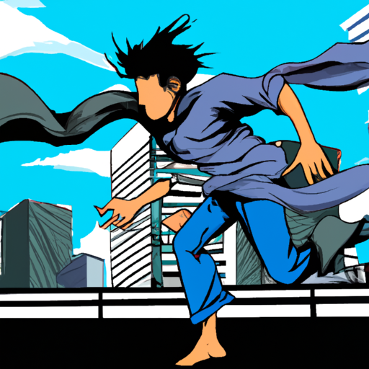
New Coming Soon: Ecclesiastes: A Striving After the Wind Wednesdays through November 8th On Zoom @ 6:15 p.m. Free PDF Book & Student Workbook available for download at www.BarrysBureau.com/Ecclesiastes.html Barry Johnson, Sr. - Facilitating

Slide 3
Taught at: Schrader Lane Church of Christ 2023
13
Review
Barry G. Johnson, Sr. - Facilitating

Slide 5
4 Keys to Positive Thinking
Key #1 Instead of defense, think offense
Cast your bread on the surface of the waters, for you will find it after many days. - Ecc. 11:1

Slide 6
4 Keys to Positive Thinking
Key #2 Instead of hoarding, try giving
Divide your portion to seven, or even to eight, for you do not know what misfortune may occur on the earth. - Ecc. 11:2

Slide 7
4 Keys to Positive Thinking
Key #3 Instead of watching, try doing
If the clouds are full, they pour out rain upon the earth; and whether a tree falls toward the south or toward the north, wherever the tree falls, there it lies. He who watches the wind will not sow and he who looks at the clouds will not reap. - Ecc. 11:3-4

Slide 8
4 Keys to Positive Thinking
Key #4 Instead of doubting, try trusting
Just as you do not know the path of the wind and how bones are formed in the womb of the pregnant woman, so you do not know the activity of God who makes all things. - Ecc. 11:5

Slide 9
Sow your seed in the morning and do not be idle in the evening, for you do not know whether morning or evening sowing will succeed, or whether both of them alike will be good.
- Ecc. 11:6

Slide 10
Procrastination = a form of Laziness and Self-Centeredness

Slide 11
Procrastination = Form of Greed

Slide 12
Joy & Satisfaction Relationship
with God

Slide 13
SATISFACTION
RELATIONSHIP
- God permits us to enjoy life now
The light is pleasant, and it is good for the eyes to see the sun. Indeed, if a man should live many years, let him rejoice in them all - Ecc. 11:7-8a

Slide 14
SATISFACTION
RELATIONSHIP
- Take advantage of your blessings now Rejoice, young man, during your childhood, and let your heart be pleasant during the days of young manhood. And follow the impulses of your heart and the desires of your eyes. - Ecc. 11:9a

Slide 15
SATISFACTION
RELATIONSHIP
- There are no guarantees
and let him remember the days of darkness, for they will be many. Everything that is to come will be futility. Yet know that God will bring you to judgment for all these things. So, remove grief and anger from your heart and put away pain from your body, because childhood and the prime of life are fleeting. - Ecc. 11:8b; 9b-10

Slide 16
SATISFACTION
RELATIONSHIP
- The essential ingredient for happiness today is to have a relationship with God today Remember also your Creator in the days of your youth, before the evil days come and the years draw near when you will say, “I have no delight in them”; - Ecc. 12:1

Slide 17
God’s love and will are the only things you can legitimately desire more and more of without harming yourself.

Slide 18
Growing Old Gracefully
Accept the obvious
before the sun and the light, the moon and the stars are darkened, and clouds return after the rain;
- Ecc. 12:2

Slide 19
in the day that the watchmen of the house tremble, and mighty men stoop, the grinding ones stand idle because they are few, and those who look through windows grow dim; and the doors on the street are shut as the sound of the grinding mill is low, and one will arise at the sound of the bird, and all the daughters of song will sing softly.
- Ecc. 12:3-4

Slide 20
Furthermore, men are afraid of a high place and of terrors on the road; the almond tree blossoms, the grasshopper drags himself along, and the caperberry is ineffective. For man goes to his eternal home while mourners go about in the street.
- Ecc. 12:5

Slide 21
Growing Old Gracefully
Prepare for the obvious
Remember Him before the silver cord is broken and the golden bowl is crushed, the pitcher by the well is shattered and the wheel at the cistern is crushed; then the dust will return to the earth as it was, and the spirit will return to God who gave it. - Ecc. 12:6-7

Slide 22
Growing Old Gracefully
Acknowledge the obvious
“Vanity of vanities,” says the Preacher, “all is vanity!” In addition to being a wise man, the Preacher also taught the people knowledge; and he pondered, searched out and arranged many proverbs. - Ecc. 12:8-9

Slide 23
The Preacher sought to find delightful words and to write words of truth correctly.
The words of wise men are like goads, and masters of these collections are like well-driven nails; they are given by one Shepherd. But beyond this, my son, be warned: the writing of many books is endless, and excessive devotion to books is wearying to the body.
- Ecc. 12:10-12

Slide 24
The conclusion, when all has been heard, is: fear God and keep His commandments, because this applies to every person. For God will bring every act to judgment, everything which is hidden, whether it is good or evil.
- Ecc. 12:13-14

Slide 25
3 Final Promises
There is satisfaction in each day

Slide 26
3 Final Promises
There is satisfaction in each day
There is a peace regardless of age or position

Slide 27
3 Final Promises
There is satisfaction in each day
There is a peace regardless of age or position
There is hope when life is over

Slide 28
Ecclesiastes for Beginners Thank You

