Slide 1
The Reality of Evangelism 2023
Being versus Doing
The Who, What, When, Where, Why, and How of Evangelism
Evangelism is not simply what we do, it is who we are.

Slide 2
Chapter 1 Who: Being an Evangelism vs. Doing Evangelism
Thesis/ Central Idea:
Principles of perseverance and patience
relentless faith and trusting God's timing,
crucial responsibility and privilege
God's constant presence and support
Notes:
Thesis/ Central Idea:
Thesis "Chapter 1 - Who" underscores the principles of perseverance and patience in evangelism, highlighting their distinct roles in maintaining relentless faith and trusting God's timing, and emphasizes the crucial responsibility and privilege of Christians to disseminate the Gospel, reminding them of God's constant presence and support in this spiritual endeavor.

Slide 3
Chapter 1 Who: Being an Evangelism vs. Doing Evangelism
A. Being Evangelism versus Doing Principles
B. Prayer: Being Evangelism Principle #1
C. Proclaim: Being Evangelism Principle #2
D. Perseverance: Being Evangelism Principle #3
E. Patience: Being Evangelism Principle #4
F. If Not Us Then, Who?
Notes:
Summary Chapter 1 - Who
Being Evangelism revolves around vital principles like "perseverance" and "patience." "Perseverance" propels us to continue our spiritual journey amidst trials, drawing strength from Galatians 6:9 (NIV) and 1 Corinthians 15:58 (NIV), which remind us of the fruitful outcomes of our unwavering commitment. Evangelism is a process, not a one-off event, requiring steadfast, long-term dedication. "Patience," another integral component of "Being Evangelism," relates to the personal nature of faith and people's timelines in accepting it. It's about trusting in God's timing for spiritual growth, practicing empathy, and respecting individual faith journeys.
Though patience and perseverance play vital roles in evangelism, they serve distinct purposes. Patience pertains to calmly waiting for someone to embrace faith, while "perseverance" focuses on the continued effort of sharing the Gospel and living out faith despite opposition or indifference. Patience governs our responses, while perseverance shapes our mission. In essence, "perseverance" is about sharing Christ's love relentlessly, whereas "patience" pertains to trusting God's timing for the transformation of hearts.
The phrase, "If not us, then who?" is a powerful call to action for Christians in spreading the Gospel. It underlines Christians' responsibility and privilege in disseminating the Good News of Jesus Christ. Evangelism is an integral part of Christian discipleship and service to God. Many will remain unaware of God's love and salvation if Christians do not take up this mantle. Despite the challenges, it's important to remember that God accompanies and equips His followers in this spiritual endeavor. The message ends on a powerful note with Matthew 28:20, reminding us of God's constant presence and support.

Slide 4
Chapter 1 Who: Being an Evangelism vs. Doing Evangelism
What principle of "Being Evangelism" does Galatians 6:9 (NIV) emphasize?
Notes:
Galatians 6:9 (ESV)
9 And let us not grow weary of doing good, for in due season we will reap, if we do not give up.

Slide 5
Chapter 2 What: Defining Biblical Evangelism
Thesis/ Central Idea:
Biblical evangelism,
acting as heralds
core elements of
Christ's willing sacrifice,
His undeniable death,
triumphant resurrection,
and the assurance of believers' resurrection
Notes:
Thesis/ Central Idea:
Biblical evangelism, as explained in the text, entails acting as heralds of Christ's life-altering Gospel message—with core elements of Christ's willing sacrifice, His undeniable death, triumphant resurrection, and the assurance of believers' resurrection—while differentiating between evangelism (spreading the Gospel to non-believers) and discipleship (nurturing believers' spiritual maturity post-conversion), both integral to fulfilling the Great Commission.

Slide 6
Chapter 2 What: Defining Biblical Evangelism
A. Scriptural definition (Mark 16:15)
B. The message of the Gospel (1 Corinthians 15:1-4)
C. Evangelism vs Discipleship
Notes:
Summary Chapter 2 - What: Defining Biblical Evangelism
Biblical evangelism, as the text defines it, is the task of acting as Christ's heralds, delivering the life-transforming message of the Gospel with boldness and conviction. It is a holy mandate that calls the world to respond to God's offer of salvation through Christ. This evangelistic mission surpasses merely sharing personal faith narratives or intellectual persuasion and is elevated to the responsibility akin to a herald delivering a king's message.
At the heart of this evangelistic mission is the Gospel's core message, as highlighted in 1 Corinthians 15:1-4 (ESV). The crucial elements of this message include Christ's death for our sins, His burial, and His resurrection on the third day. These signify Jesus's willing sacrifice, the undeniable reality of His death, His triumphant victory over death and sin, and the assurance of believers' own resurrection and eternal life. This message underscores the necessity for believers to persist in their faith and embark on a continual journey grounded in Christ's transformative power.
The text further distinguishes between evangelism and discipleship. While evangelism involves sharing the Gospel with non-believers, introducing them to the transformative message of Jesus Christ, and leading them towards accepting Jesus as their Savior, discipleship begins post conversion. Discipleship aims at fostering spiritual maturity in believers, helping them grow in their relationship with Christ, and live a life that reflects His teachings. Both evangelism and discipleship are integral to carrying out the Great Commission, leading people to Christ, and guiding them towards spiritual growth.

Slide 7
Chapter 2 What: Defining Biblical Evangelism
What is the Gospel's central message as per 1 Corinthians 15:1-4?
Notes:
1 Corinthians 15:1–4 (ESV)
1 Now I would remind you, brothers, of the gospel I preached to you, which you received, in which you stand, 2 and by which you are being saved, if you hold fast to the word I preached to you—unless you believed in vain.
3 For I delivered to you as of first importance what I also received: that Christ died for our sins in accordance with the Scriptures, 4 that he was buried, that he was raised on the third day in accordance with the Scriptures,

Slide 8
Chapter 3 When: Recognizing Opportunities to Share the Gospel
Thesis/ Central Idea:
Recognizing opportunities
both introverts and extroverts having distinct strengths
the power and impact of evangelism lie in the Gospel message
Notes:
Thesis/ Central Idea:
The Summary of Chapter 3 underscores that recognizing opportunities to share the Gospel is significantly influenced by one's personality type, with both introverts and extroverts having distinct strengths that can be leveraged for effective evangelism, but ultimately, the power and impact of evangelism lie in the Gospel message itself, not the personality type delivering it.

Slide 9
Chapter 3 When: Recognizing Opportunities to Share the Gospel
A. Discerning readiness in others (John 4:35)
B. Utilizing life events as opportunities
C. Practical methods for sharing the gospel (1 Peter 3:15)
D. Introverts versus Extroverts

Slide 10
Chapter 3 When: Recognizing Opportunities to Share the Gospel
Question: What does 1 Peter 3:15 say about sharing the Gospel?
Notes:
1 Peter 3:15 (ESV)
15 but in your hearts honor Christ the Lord as holy, always being prepared to make a defense to anyone who asks you for a reason for the hope that is in you; yet do it with gentleness and respect,

Slide 11
Chapter 4 Where: Creating Environments for Evangelism
Thesis/ Central Idea:
Fostering open,
inviting spaces
encourage spiritual exploration,
dialogue, and ultimately, conversion
Notes:
Thesis/ Central Idea:
In the realm of evangelism, strategic creation and utilization of environments serve as potent tools in fostering open, inviting spaces that encourage spiritual exploration, dialogue, and ultimately, conversion.

Slide 12
Chapter 4 Where: Creating Environments for Evangelism
A. Always being prepared (2 Timothy 4:2)
B. Fostering environments that encourage spiritual conversations
C. Evangelism at Home
D. Evangelism in the Workplace
E. Evangelism in the Community
F. Evangelism Online
Notes:
Summary Chapter 4 - Where
The chapter emphasizes the importance of creating environments conducive to evangelism, reiterating that evangelism isn't only a planned exercise but a constant state of preparedness to share the Gospel. It explores various spheres of influence, conveying that the mission field is not limited to far-off lands but is embedded in our everyday spaces. From homes and workplaces to wider communities and online platforms, evangelism happens everywhere and should be an integral part of our lives.
The family unit and the workplace are highlighted as critical evangelism environments. Parents are urged to serve as primary evangelists to their children, fostering a culture of open conversation about faith. Similarly, the workplace provides opportunities to reflect Christ's love through work ethics and respectful interactions, creating a godly influence that arouses curiosity and fosters opportunities for spiritual conversations.
Finally, the text underscores the importance of evangelism in the broader community and online platforms. We are encouraged to be prepared to share the Gospel respectfully and meaningfully with those in our community, through acts of service or by displaying Christlike character in daily interactions. The digital age has opened up a new frontier for evangelism, allowing the Gospel to be shared globally, transcending geographical and cultural boundaries. The key is engaging in thoughtful discussions, offering spiritual support, and creating a welcoming online community where faith can be explored.

Slide 13
Chapter 4 Where: Creating Environments for Evangelism
Question: How does 2 Timothy 4:2 illustrate the preparedness required in evangelism?
Notes:
2 Timothy 4:2 (ESV)
2 preach the word; be ready in season and out of season; reprove, rebuke, and exhort, with complete patience and teaching.

Slide 14
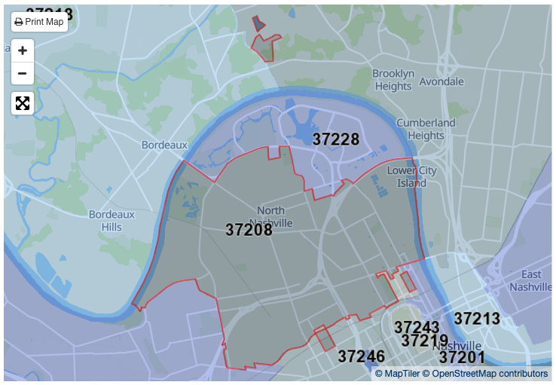
Notes:
Map of 37208 zip code same as the church building

Slide 15
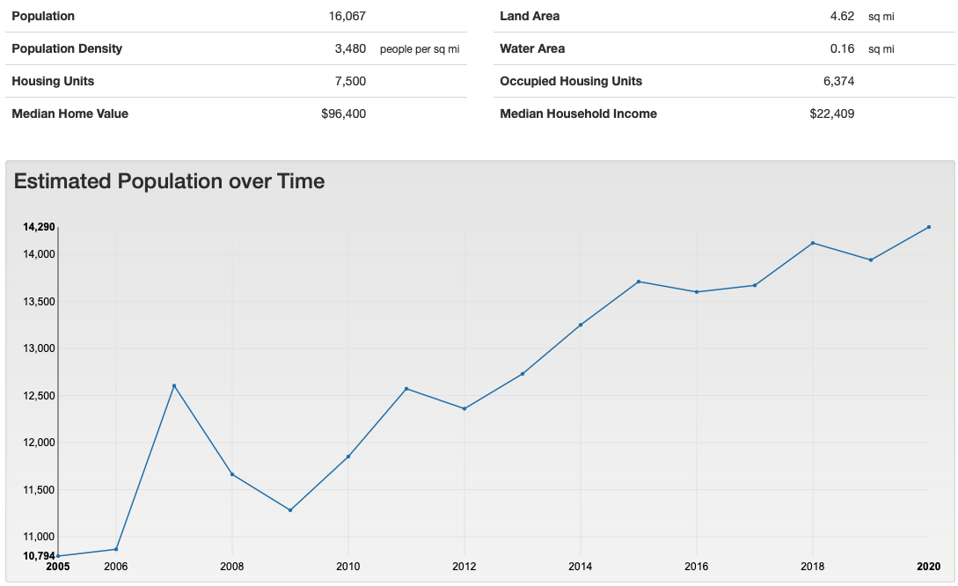
Notes:
The area is growing
Evangelism should be taking place with every individual and family that have moved into our zip code
In 2019 population was 13,940
In 2020 population was 14,290
In one year, 350 individuals should have been welcomed by SLCC almost 30 per month
This is the “Where” of Evangelism Crating Opportunites

Slide 16
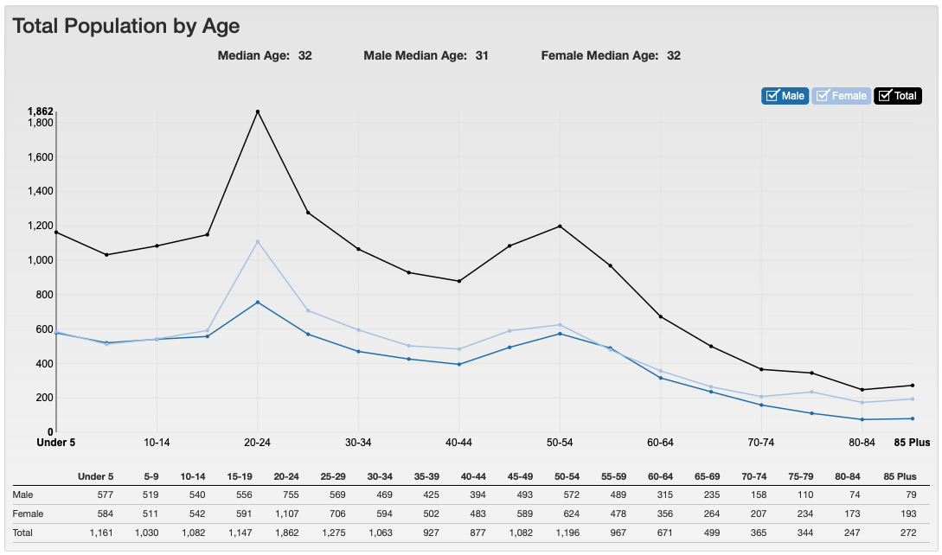
Notes:
Median Age: 32. Male 31. Female 32
1,862 Age 20-24
1,275 Age 25-29
1,196 Age 50-54
1,147 Age 15-19
1,161 Under Age 5
1,082 Age 10-14 Tied
1,082 Age 45-49 Tied
1,063 Age 30-34
1,030 Age 5-9

Slide 17
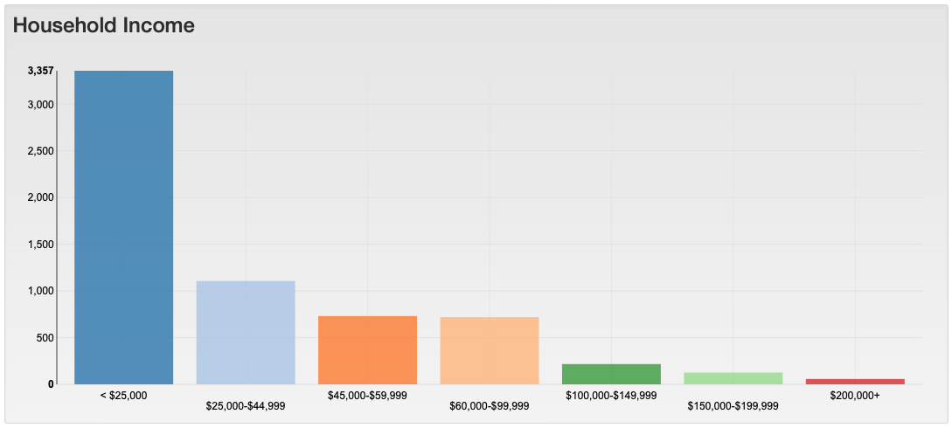
Notes:
Total Households in 37208 = 6313
< $25,000 = 3,357 households
$25,000 - $44,999 = 1,106 households
$45,000 - $59,000 = 731 households
$60,000 - $99,000 = 719 households
$100,000 - $149,000 = 217 households
$150,000 – 199,000 = 126 households
$200,000+ = 57 households

Slide 18
Religious and Denominations Chart Zip code 37208
Percent Religious 59.6%
Non-Religious 40.4% = 6,491
Protestants 44.5% = 7.149
Baptist 20.6%
Catholic 6.2%
All Other Protestants 15.2%
Other Christian 15.7%
Notes:
40% approximately non-religious = 6,491 people in 37208
Using the Pentecost Paradigm of .3% or .003 times 6,491 would equal 19.473 potential baptisms
44.5% approximately Protestant believers = 7,149
Using the Pentecost Paradigm of .3% or .003 times 7,149 would equal 21.447 potential baptisms
That’s a total of 40 potential baptisms from these two groups

Slide 19
Chapter 5 Why: The Importance of Sharing the Gospel
Thesis/ Central Idea:
Fundamental teachings of faith,
propagates spiritual growth,
and provides a beacon of hope
and redemption to humanity."
Notes:
Thesis/ Central Idea:
"Upholding and communicating the Gospel is paramount as it embodies the fundamental teachings of faith, propagates spiritual growth, and provides a beacon of hope and redemption to humanity."

Slide 20
Chapter 5 Why: The Importance of Sharing the Gospel
A. Scriptural mandates (Romans 10:14-15)
B. The love of Christ compels us (2 Corinthians 5:14)
C. The eternal significance (John 3:16)
Notes:
Summary Chapter 5 - Why
Evangelism, or sharing the Gospel, holds deep significance in the Christian faith. Its importance lies in bringing others to Christ, nurturing new believers, and fostering spiritual growth for both the evangelist and recipient. This action strengthens the evangelist's understanding of the Gospel, deepens their faith, and cultivates compassion. For the recipient, it offers an opportunity to experience God's love, find hope, and become part of a spiritual family.
Romans 10:14-15 and 2 Corinthians 5:14 mandate and motivate us to evangelize. Romans clearly states that belief in Christ comes from hearing His word, possible only through evangelism. It underscores that each Christian has a role to play in spreading the Gospel, reminding us of this work's beauty and transformative power. 2 Corinthians 5:14 further motivates us by highlighting that the love of Christ compels us to evangelize. This is not a duty, but a compelling act of love, an active and powerful force that encourages us to extend beyond our comfort zones to share the message of love, forgiveness, and hope.
Finally, John 3:16 highlights the eternal significance of evangelism. The verse encapsulates the grand narrative of the Gospel, demonstrating God's profound love for humanity and His promise of eternal life through belief in Christ. Evangelism thus becomes a divine invitation extended from a place of love, echoing God's heart and willingness to sacrifice His only Son for humanity's salvation. By sharing our faith, we partake in this divine assignment, inviting others into a life-changing relationship with Jesus Christ.

Slide 21
Chapter 5 Why: The Importance of Sharing the Gospel
Question: What does Romans 10:14-15 emphasize about sharing our faith?
Notes:
Romans 10:14–15 (ESV)
14 How then will they call on him in whom they have not believed? And how are they to believe in him of whom they have never heard? And how are they to hear without someone preaching? 15 And how are they to preach unless they are sent? As it is written, “How beautiful are the feet of those who preach the good news!”

Slide 22
Chapter 6 How: Connecting People to Their Need for the Gospel
Thesis/ Central Idea:
"Connecting People to Their Need for the Gospel"
inherent human desire for salvation,
providing a transformative path
redemptive power of the Gospel
Notes:
Thesis/ Central Idea:
"Connecting People to Their Need for the Gospel" is a crucial endeavor that illuminates the inherent human desire for salvation, providing a transformative path towards acknowledging personal imperfections and embracing the profound, redemptive power of the Gospel.

Slide 23
Chapter 6 How: Connecting People to Their Need for the Gospel
A. Understanding humanity's need for salvation (Romans 3:23; Romans 6:23)
B. Practical examples of sharing the Gospel
C. Simple exercises for articulating the Gospel clearly
Notes:
Summary Chapter 6 - How
The first section of the text emphasizes an understanding of two significant verses from Romans: Romans 3:23 and Romans 6:23. Romans 3:23 uncovers the universal nature of humanity's sinful condition that separates us from God. Romans 6:23 reveals the consequences of sin—spiritual death—but it also introduces the antidote: the gift of God, which is eternal life through Jesus Christ. These verses highlight the inescapable need for salvation that can only be fulfilled by Christ's redeeming work, underscoring the importance of sharing this message with others, thereby connecting people to their need for the Gospel.
The text discusses practical examples of sharing the Gospel in everyday scenarios. As exemplified by Jen's conversation with Laura, personal conversations and shared experiences can serve as catalysts for faith discussions. Demonstrating Christ's love through actions, like Tom's volunteering at a homeless shelter, can also pique interest in the Gospel. Additionally, leveraging technology and social media, as Alice did through her Instagram account, can reach a broad audience and open up discussions about faith, emphasizing that every interaction can be an opportunity to share the Gospel.
Lastly, the text offers simple exercises to assist in articulating the Gospel clearly. Crafting a personal testimony can help relate one's faith journey concisely and relatable. The Bridge Illustration is a visual tool highlighting humanity's need for salvation and God's provision through Christ. Memorizing key scriptures that explain the Gospel message can also aid in explaining it confidently using the Bible's words. These exercises, along with understanding humanity's inherent need for salvation and taking advantage of everyday scenarios to share the Gospel, effectively connect people to their need for the Gospel.

Slide 24
Chapter 6 How: Connecting People to Their Need for the Gospel
Question: What is the significance of Romans 6:23 in the context of salvation?

