Slide 1
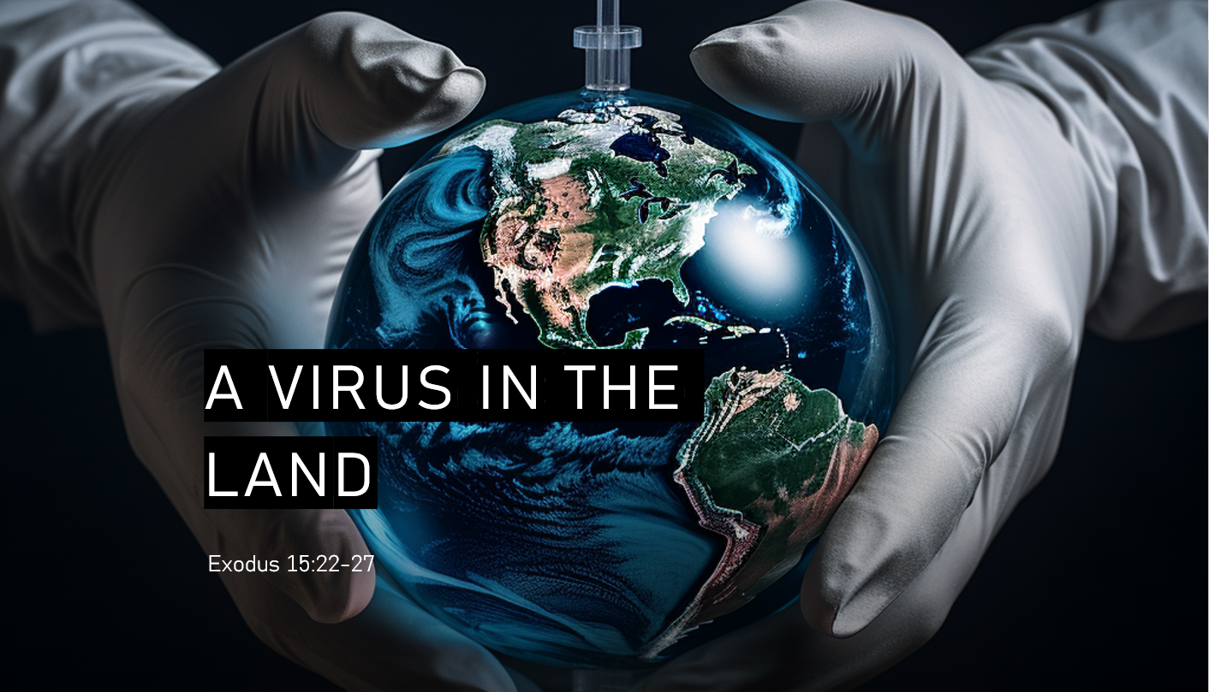

Slide 2
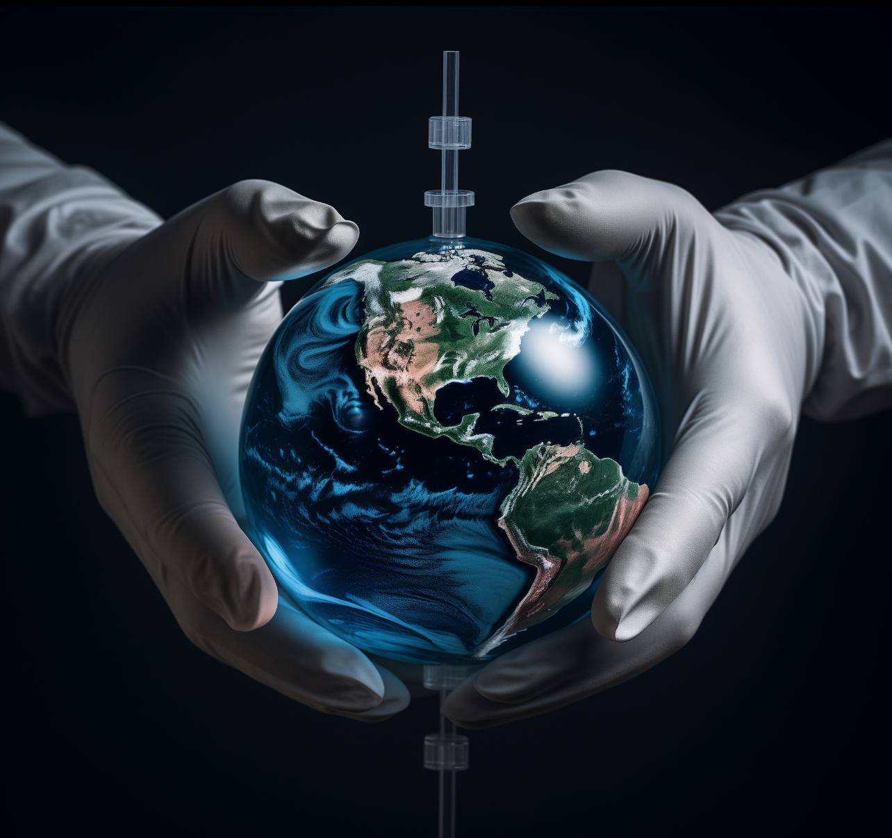

Slide 3
22 Then Moses made Israel set out from the Red Sea, and they went into the wilderness of Shur. They went three days in the wilderness and found no water.
Exodus 15:22–27
ESV

Slide 4
23 When they came to Marah, they could not drink the water of Marah because it was bitter; therefore it was named Marah.
Exodus 15:23
ESV

Slide 5
24 And the people grumbled against Moses, saying, “What shall we drink?”
Exodus 15:24
ESV

Slide 6
25 And he cried to the Lord, and the Lord showed him a log, and he threw it into the water, and the water became sweet. There the Lord made for them a statute and a rule, and there he tested them,
Exodus 15:25
ESV

Slide 7
26 saying, “If you will diligently listen to the voice of the Lord your God, and do that which is right in his eyes, and give ear to his commandments and keep all his statutes, I will put none of the diseases on you that I put on the Egyptians, for I am the Lord, your healer.”
Exodus 15:26
ESV

Slide 8
27 Then they came to Elim, where there were twelve springs of water and seventy palm trees, and they encamped there by the water.
Exodus 15:27
ESV

Slide 9
1. Vision - Divine Revelation

Slide 10
23 for all have sinned and fall short of the glory of God,
Romans 3:23–25
ESV

Slide 11
24 and are justified by his grace as a gift, through the redemption that is in Christ Jesus,
Romans 3:24–25
ESV

Slide 12
25 whom God put forward as a propitiation by his blood, to be received by faith. This was to show God’s righteousness, because in his divine forbearance he had passed over former sins.
Romans 3:25
ESV

Slide 13
24 He himself bore our sins in his body on the tree, that we might die to sin and live to righteousness. By his wounds you have been healed.
1 Peter 2:24
ESV

Slide 14
16 “For God so loved the world, that he gave his only Son, that whoever believes in him should not perish but have eternal life.
John 3:16
ESV

Slide 15
2. Strategy - Divine Plan

Slide 16
7 In him we have redemption through his blood, the forgiveness of our trespasses, according to the riches of his grace,
Ephesians 1:7
ESV

Slide 17
17 Therefore, if anyone is in Christ, he is a new creation. The old has passed away; behold, the new has come.
2 Corinthians 5:17
ESV

Slide 18
10 Create in me a clean heart, O God, and renew a right spirit within me.
Psalm 51:10
ESV

Slide 19
3. Execution - Obedience

Slide 20
23 Jesus answered him, “If anyone loves me, he will keep my word, and my Father will love him, and we will come to him and make our home with him.
John 14:23
ESV

Slide 21
19 For as by the one man’s disobedience the many were made sinners, so by the one man’s obedience the many will be made righteous.
Romans 5:19
ESV

Slide 22
22 Having purified your souls by your obedience to the truth for a sincere brotherly love, love one another earnestly from a pure heart,
1 Peter 1:22
ESV

Slide 23
1. Vision - Divine Revelation
2. Strategy - Divine Plan
3. Execution - Obedience

