Slide 1
Taught at: Schrader Lane Church of Christ 2023
8
Worship Attitude
Ecc. 5:1-6:12
Barry G. Johnson, Sr. - Facilitating

Slide 2
New Coming Soon: Ecclesiastes: A Striving After the Wind Wednesdays through November 8th On Zoom @ 6:15 p.m. Free PDF Book & Student Workbook available for download at www.BarrysBureau.com/Ecclesiastes.html Barry Johnson, Sr. - Facilitating

Slide 3
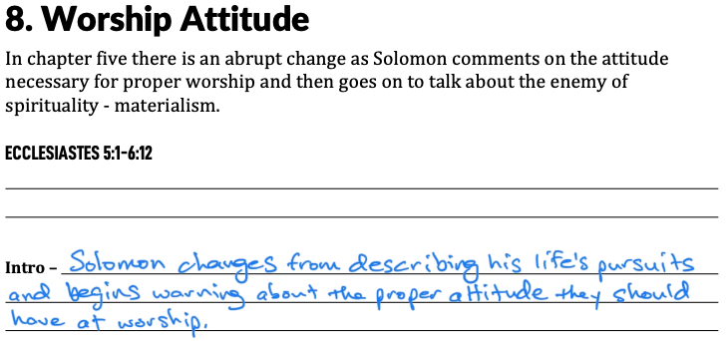

Slide 4
Worship Attitude
Pay Attention
Guard your steps as you go to the house of God and draw near to listen rather than to offer the sacrifice of fools; for they do not know they are doing evil.
-Ecc. 5:1

Slide 5
Worship Attitude
Guard Your Mind
Do not be hasty in word or impulsive in thought to bring up a matter in the presence of God. For God is in heaven and you are on the earth; therefore let your words be few. For the dream comes through much effort and the voice of a fool through many words.
-Ecc. 5:2-3

Slide 6
For in many dreams and in many words there is emptiness. Rather, fear God.
- Ecc. 5:7

Slide 7
Worship Attitude
Keep Your Promises
When you make a vow to God, do not be late in paying it; for He takes no delight in fools. Pay what you vow! It is better that you should not vow than that you should vow and not pay.
-Ecc. 5:4-5

Slide 8
Do not let your speech cause you to sin and do not say in the presence of the messenger of God that it was a mistake. Why should God be angry on account of your voice and destroy the work of your hands?
- Ecc. 5:6

Slide 9
Folly of Riches
Absolute Power Corrupts
If you see oppression of the poor and denial of justice and righteousness in the province, do not be shocked at the sight, for one official watches over another official, and there are higher officials over them. After all, a king who cultivates the field is an advantage to the land.
- Ecc. 5:8-9

Slide 10
Folly of Riches
Greater Wealth Does Not Equal Greater Satisfaction
He who loves money will not be satisfied with money, nor he who loves abundance with its income. This too, is vanity.
- Ecc. 5:10

Slide 11
Folly of Riches
More Money = More Worries
When good things increase, those who consume them increase. So what is the advantage to their owners except to look on?
- Ecc. 5:11

Slide 12
The sleep of the working man is pleasant, whether he eats little or much; but the full stomach of the rich man does not allow him to sleep.
- Ecc. 5:12

Slide 13
Folly of Riches
You Can’t Take It With You
There is a grievous evil which I have seen under the sun: riches being hoarded by their owner to his hurt. When those riches were lost through a bad investment and he had fathered a son, then there was nothing to support him.
- Ecc. 5:13-14

Slide 14
As he had come naked from his mother’s womb, so will he return as he came. He will take nothing from the fruit of his labor that he can carry in his hand.
- Ecc. 5:15

Slide 15
Folly of Riches
Live High-Die Hard
This also is a grievous evil—exactly as a man is born, thus will he die. So what is the advantage to him who toils for the wind? Throughout his life he also eats in darkness with great vexation, sickness and anger.
- Ecc. 5:16-17

Slide 16
Right Attitude = 3 Gifts
True Enjoyment
Here is what I have seen to be good and fitting: to eat, to drink and enjoy oneself in all one’s labor in which he toils under the sun during the few years of his life which God has given him; for this is his reward.
-Ecc. 5:18

Slide 17
Right Attitude = 3 Gifts
True Enjoyment
Fulfillment In Your Work
Furthermore, as for every man to whom God has given riches and wealth, He has also empowered him to eat from them and to receive his reward and rejoice in his labor; this is the gift of God.
-Ecc. 5:19

Slide 18
Right Attitude = 3 Gifts
True Enjoyment
Fulfillment In Your Work
General Contentment
For he will not often consider the years of his life, because God keeps him occupied with the gladness of his heart.
-Ecc. 5:20

Slide 19
There is an evil which I have seen under the sun and it is prevalent among men— a man to whom God has given riches and wealth and honor so that his soul lacks nothing of all that he desires; yet God has not empowered him to eat from them, for a foreigner enjoys them. This is vanity and a severe affliction.
- Ecc. 6:1-2

Slide 20
If a man fathers a hundred children and lives many years, however many they be, but his soul is not satisfied with good things and he does not even have a proper burial, then I say, “Better the miscarriage than he, for it comes in futility and goes into obscurity; and its name is covered in obscurity.
- Ecc. 6:3-4

Slide 21
It never sees the sun and it never knows anything; it is better off than he. Even if the other man lives a thousand years twice and does not enjoy good things—do not all go to one place?”
All a man’s labor is for his mouth and yet the appetite is not satisfied.
- Ecc. 6:5-7

Slide 22
For what advantage does the wise man have over the fool? What advantage does the poor man have, knowing how to walk before the living? What the eyes see is better than what the soul desires. This too is futility and a striving after wind.
- Ecc. 6:8-9

Slide 23
Solomon’s Observations
God is Sovereign
Whatever exists has already been named,
-Ecc. 6:10a

Slide 24
Solomon’s Observations
God is Sovereign
Man is Not Sovereign
and it is known what man is; -Ecc. 6:10b

Slide 25
Solomon’s Observations
God is Sovereign
Man is Not Sovereign
Disputing With God Is A Waste Of Time
for he cannot dispute with him who is stronger than he is. For there are many words which increase futility. What then is the advantage to a man?
-Ecc. 6:10c-11

Slide 26
For who knows what is good for a man during his lifetime, during the few years of his futile life? He will spend them like a shadow. For who can tell a man what will be after him under the sun?
- Ecc. 6:12

Slide 27
Solomon’s Search Has Yielded:
Disillusionment
Discontent
Depression

Slide 28
Solomon begins to search for life “Above the Sun”

