Slide 1
The Reality of Evangelism
Being versus Doing

Slide 2
Evangelism is not simply what we do, it is who we are.

Slide 3
barrysbureau.com
Lesson #10 Evangelism - Who Digital Form

Slide 4
Introduction
Who - Us and Them
What - Defining Evangelism
When - Recognizing Opportunities
Where - Concentrated efforts
Why - Expressing God’s Love
How - Connecting People
Conclusion

Slide 6
Who: Being vs. Doing
Notes:
The Who in Evangelism is you. That we might engage efficiently and regularly in Evangelism requires a shift in our thinking. The shift is moving from Doing Evangelism to Being Evangelistic as a matter of our character and personality as the new creation born again of the Spirit (John 3:3,7).
The hearts of humankind is God's work. Men try to use results to paint a picture of their hearts. Doing is an external activity endeavoring to cause an internal change. Doing starts on the outside, trying to change the inside. While on the other hand, Being is an inner activity that reflects an internal reality. Being starts from the inside, reflecting what already exists internally in the souls of men.
Luke 16:15 (ESV): 15 And he said to them, "You are those who justify yourselves before men, but God knows your hearts. For what is exalted among men is an abomination in the sight of God.
God works with humankind according to what is in their hearts, not what is on their resume. Jeremiah 17:9 teaches us that the heart is deceitful above all things. Evangelism must come from the heart and not from a keeping score mentality or works we believe earn us heaven. As Christians, our labors should be a reflection of our hearts, a light shining outward from an inward source. We do not labor for men to see and reward us for doing good. Christian labor is the natural outgrowth of a heart aligned with the purposes of God.
So let's look more at Being versus Doing where Evangelism is concerned.

Slide 8
A. Being Evangelism versus Doing Principles
Praying
Proclaiming
Perseverance
Patience
Conversion
Notes:
Praying: The cornerstone of evangelism, fostering connection with God, and seeking divine wisdom for sharing the gospel.
Proclaiming: Essential in communicating God's truth and explaining the transformative power of Christ's love.
Perseverance: An integral trait for evangelists, facing challenges, rejections, and misunderstandings with unwavering determination.
Patience: A reminder of God's divine timing in conversion, encouraging continuous service and love.
Conversion: A divine act occurring in God's timing, demonstrating the power and effectiveness of patient, persistent evangelism.
A1. What essential principles are included in "Being Evangelism?"
1. Praying and Protesting
2. Proclaiming and Procrastinating
3. Praying, Proclaiming, Persevering, and Patience
4. Persevering and Panicking
A2. "Being Evangelism" does not require patience as conversion occurs instantaneously.
False

Slide 9
Notes:
Write on top of the “Doing Head” = Human(Worldly; Fleshly; Carnal; Temporal) Effort
Write on top of the “Being Head” = Spiritual(Heavenly; Spirit; Divine; Eternal) Effort

Slide 10
B. Prayer: Being Evangelism Principle #1
Prayer the cornerstone of evangelism
Through prayer, we shift our perspective
1 Thessalonians 5:17
hearts connected to God
equips and guides
Notes:
Prayer is the cornerstone of evangelism, serving as our direct line of communication with God and aligning our hearts with His will.
Through prayer, we shift our perspective from our capabilities to God's omnipotence, reinforcing our reliance on Him for successful evangelism.
The Bible instructs us in 1 Thessalonians 5:17 to "pray without ceasing," which should guide our approach to evangelism.
Continuous prayer for those we aim to reach with the Gospel keeps our hearts connected to God, allowing His love and grace to flow through us.
Prayer is not just an initial step in evangelism; it is an essential, ongoing practice that equips and guides us in sharing Christ's love and redemption.
B1. What is the role of prayer in "Being Evangelism," according to the text?
1. Prayer is solely a preparatory act in evangelism.
2. Prayer is a secondary aspect of evangelism.
3. Prayer is an essential, ongoing practice in evangelism.
4. Prayer has no significant role in evangelism.
B2. Prayer in "Being Evangelism" shifts our perspective from our capabilities to God's omnipotence.
True

Slide 11
Notes:
Write on the slide “Access to Omnipotence” = All Power
Pray takes us out of human effort to spiritual effort
Pray equips and guides us

Slide 12
C. Proclaim: Being Evangelism Principle #2
Romans 10:14-15 (NIV)
responsibility of every Christian
Matthew 28:19-20 (NIV)
share the message of salvation
love, grace, and truth
Notes:
Being Evangelism calls upon us to proclaim God's Word as per Romans 10:14-15 (NIV), demonstrating our role as bearers of the Good News and agents of transformative faith.
Proclaiming the Gospel is not exclusive to church leaders or missionaries; it is the responsibility of every Christian.
The Great Commission in Matthew 28:19-20 (NIV) is inclusive, applying to all followers of Christ irrespective of their position, vocation, or status.
Every Christian is called to share the message of salvation and lead others toward a personal relationship with Jesus.
In practicing Being Evangelism, we must embody and reflect the love, grace, and truth of Christ's message in our lives.
C1. Who proclaims the Gospel in "Being Evangelism?”
1. Only church leaders and missionaries
2. Only those with a theological education
3. All followers of Christ, regardless of position, vocation, or status
4. Only those personally chosen by God
C2. Proclaiming the Gospel is selective, applying only to specific followers of Christ.
False

Slide 14
7. What does Matthew 28:20 promise to believers in the context of evangelism?
Notes:
Matthew 28:20 promises believers that God Himself is with them, equipping them, strengthening them, and guiding them as they fulfill their calling, "Surely I am with you always, to the very end of the age."

Slide 15
D. Perseverance: Being Evangelism Principle #3
Perseverance in Evangelism:
Biblical Assurance:
Evangelism as a Process:
Steadfastness and Commitment:
Continual Dedication:
Notes:
Perseverance in Evangelism: Evangelism is a spiritual pursuit often filled with challenges, requiring steadfastness to press forward despite hurdles.
Biblical Assurance: Galatians 6:9 assures us of a fruitful harvest if we do not give up in doing good, emphasizing the importance of persistence in evangelistic efforts.
Evangelism as a Process: Evangelism is a long-term process, not a one-time event. It often takes multiple encounters with the Gospel for a person to embrace Christ.
Steadfastness and Commitment: Our labor in evangelism should be marked by unwavering commitment and steadfast dedication.
Continual Dedication: 1 Corinthians 15:58 encourages us to stand firm and fully dedicate ourselves to the work of the Lord, assuring us that our efforts in evangelism are never in vain.
D1. What does Galatians 6:9 (NIV) suggest about the importance of perseverance in evangelism?
1. It suggests that evangelism should be a one-time event.
2. It indicates that we should give up when faced with challenges in evangelism.
3. It underscores the importance of persisting in evangelistic endeavors, promising that efforts are not in vain.
4. It has no connection with the concept of perseverance in evangelism.
D2. A short-term commitment should characterize evangelism.
False

Slide 16
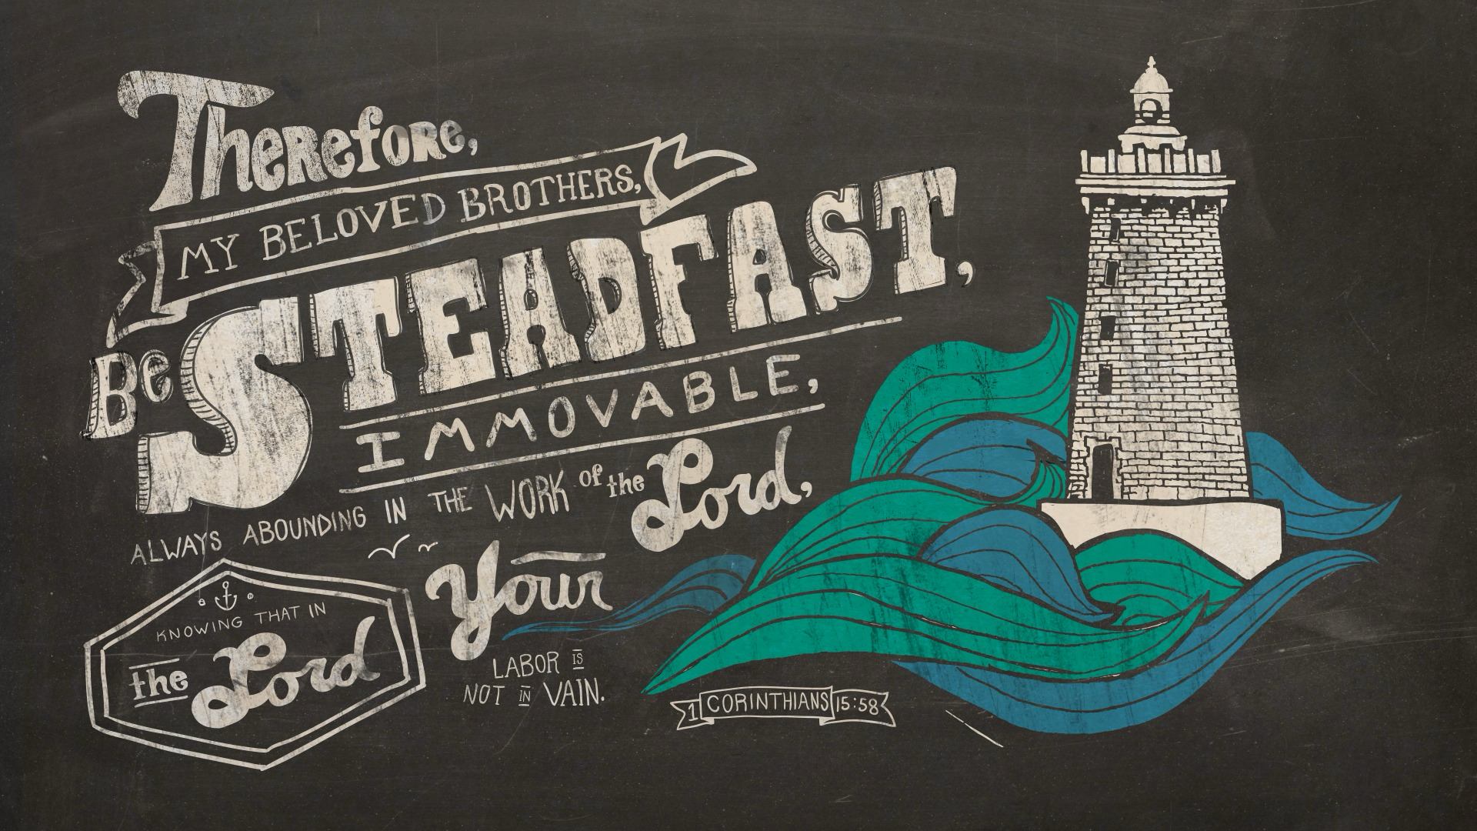
Notes:
Circle “steadfast” Write in “perseverance”

Slide 17
1. What principle of "Being Evangelism" does Galatians 6:9 (NIV) emphasize?
Notes:
Galatians 6:9 (NIV) emphasizes the principle of Perseverance in "Being Evangelism." It encourages believers not to become weary in doing good and assures them that they will reap a harvest if they do not give up.

Slide 18
2. How is evangelism described in terms of its duration and commitment?
Notes:
Answer:
Evangelism is described as a process, often a long one, and not merely a one-time event. It requires steadfastness and a long-term, unwavering commitment.

Slide 19
3. What does 1 Corinthians 15:58 (NIV) encourage in evangelism?
Notes:
1 Corinthians 15:58 (NIV) encourages believers to remain steadfast and continually dedicate themselves to evangelism and assures them that their efforts in the Lord are never futile.

Slide 20
E. Patience: Being Evangelism Principle #4
faith at their own pace
plant and water
empathy and understanding
sharing and living our faith
God's timing
Notes:
Patience is a critical component of Being Evangelism, allowing individuals the space to explore their faith at their own pace without feeling rushed or pressured.
Our role in evangelism is to plant and water the seed of faith, trusting in God's timing for growth, even if immediate results are not visible.
Patience in evangelism encompasses empathy and understanding, accepting questions, doubts, and thoughts without judgment.
Perseverance in evangelism is about consistently sharing the gospel and living our faith, even when met with rejection, indifference, or hostility.
While perseverance is about our persistent efforts, patience refers to our calm approach to the responses received, trusting in God's timing for transformation.
E1. What does patience in evangelism entail?
1. Forcing the process and rushing people to accept Christ
2. Ignoring doubts and questions that people may have
3. Waiting calmly for someone to come to faith, showing empathy and understanding, and trusting in God's timing
4. There's no need for patience in evangelism
E2. Patience and perseverance serve identical functions in evangelism.
False

Slide 21
Notes:
Next to the seed, write “word”

Slide 22
4. What role does patience play in the context of Being Evangelism?
Patience is crucial in Evangelism as it allows believers to wait calmly for someone to come to faith. It also manifests as empathy and understanding, allowing people to wrestle with their thoughts, doubts, and questions.
Notes:
Patience is crucial in Evangelism as it allows believers to wait calmly for someone to come to faith. It also manifests as empathy and understanding, allowing people to wrestle with their thoughts, doubts, and questions.

Slide 23
5. How are patience and perseverance different in their functions within evangelism?
Perseverance refers to the continued effort to do or achieve something despite difficulties, failure, or opposition, while patience is the capacity to wait calmly for someone to come to faith. In evangelism, perseverance is consistently sharing the gospel and living out our faith, even when we face rejection, indifference, or hostility. In contrast, patience is about waiting on God's timing to transform hearts and minds without becoming disheartened by an apparent lack of progress.
Notes:
Perseverance refers to the continued effort to do or achieve something despite difficulties, failure, or opposition, while patience is the capacity to wait calmly for someone to come to faith. In evangelism, perseverance is consistently sharing the gospel and living out our faith, even when we face rejection, indifference, or hostility. In contrast, patience is about waiting on God's timing to transform hearts and minds without becoming disheartened by an apparent lack of progress.

Slide 24
F. If Not Us Then, Who?
a call to action
not for ourselves alone
The Urgency of Evangelism
Embracing our Role
we are not alone
Notes:
"If Not Us, Then Who?" - This phrase serves as a call to action for Christians to spread the Gospel, reminding us of our unique role and responsibility.
Evangelism as an Integral Part of Christian Life - Our faith is not for ourselves alone; it is meant to be shared and witnessed by others, making evangelism a key aspect of our service to God.
The Urgency of Evangelism - The world is full of people who have yet to discover God's love and salvation; if we do not bridge this gap, many will continue to live in ignorance.
Embracing our Role as Christian Evangelists - We must rise to the call, overcoming fear, doubt, or complacency, and remember that it is an honor and privilege to serve as God's messengers.
God's Assurance to His Followers - Despite the challenges of evangelism, we must remember that we are not alone; God Himself is with us, equipping and guiding us as we fulfill our calling.
F1. What is implied by the phrase "If not us, then who?" in the context of evangelism?
1. It suggests that evangelism is optional for Christians.
2. It implies that only a select few are called to evangelize.
3. It indicates that God alone is responsible for spreading His message.
4. It serves as a call to action for Christians to take up the mantle of evangelism, highlighting their unique role in spreading God's love.
F2. The task of evangelism can be daunting, but Christians can take comfort in the assurance of God's guidance and presence.
True

Slide 25
God doesn’t call the qualified;
God qualifies the called
1 Corinthians 1:27 (ESV)
27 But God chose what is foolish in the world to shame the wise; God chose what is weak in the world to shame the strong;
Notes:
Underline “foolish” and “weak” draw a line to qualifies

Slide 26
6. What does the phrase "If not us, then who?" signify in the context of evangelism?
The phrase "If not us, then who?" is a powerful reminder and a call to action for Christians. It signifies that if those who have experienced the transformative power of God's grace and love do not take up the mantle of evangelism, then who will?
Notes:
The phrase "If not us, then who?" is a powerful reminder and a call to action for Christians. It signifies that if those who have experienced the transformative power of God's grace and love do not take up the mantle of evangelism, then who will?

