Slide 1
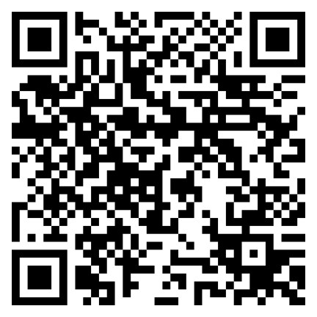
The Keys to Steadfast Faith
Hebrews 12:1-2
Keep Your Eyes on Jesus

