Slide 2
God’s Vision

Slide 3
God Views all Life on Earth
2 Chronicles 16:9 (NIV) —
9 For the eyes of the Lord range throughout the earth to strengthen those whose hearts are fully committed to him. You have done a foolish thing, and from now on you will be at war.”

Slide 4
God Views all Life on Earth
Psalm 11:4 (NIV) —
4 The Lord is in his holy temple; the Lord is on his heavenly throne. He observes everyone on earth; his eyes examine them.

Slide 5
God Sees the Hearts and
Thoughts of People
Genesis 6:5 (NIV) —
5 The Lord saw how great the wickedness of the human race had become on the earth, and that every inclination of the thoughts of the human heart was only evil all the time.

Slide 6
The Physical Vision of Human Beings

Slide 7
It is Given and Can be
Taken by God
Exodus 4:11 (NIV) —
11 The Lord said to him, “Who gave human beings their mouths? Who makes them deaf or mute? Who gives them sight or makes them blind? Is it not I, the Lord?

Slide 8
It is Given and Can be
Taken by God
Psalm 146:8 (NIV) —
8 the Lord gives sight to the blind, the Lord lifts up those who are bowed down, the Lord loves the righteous.

Slide 9
Jesus Christ Restores the
Sight of the Blind
Luke 4:18 (NIV) —
18 “The Spirit of the Lord is on me, because he has anointed me to proclaim good news to the poor. He has sent me to proclaim freedom for the prisoners and recovery of sight for the blind, to set the oppressed free,

Slide 10
Physical Vision has its Dangers

Slide 11
It Can Create Fear
Job 41:9 (NIV) —
9 Any hope of subduing it is false; the mere sight of it is overpowering.

Slide 12
It Can Create Fear
Joel 2:6 (NIV) —
6 At the sight of them, nations are in anguish; every face turns pale.

Slide 13
It Can Create Fear
Matthew 28:3–4 (NIV) —
3 His appearance was like lightning, and his clothes were white as snow. 4 The guards were so afraid of him that they shook and became like dead men.

Slide 14
It Can Create Fear
Revelation 1:17 (NIV) —
17 When I saw him, I fell at his feet as though dead. Then he placed his right hand on me and said: “Do not be afraid. I am the First and the Last.

Slide 15
It Gives Rise to Temptation
1 John 2:16 (NIV) —
16 For everything in the world—the lust of the flesh, the lust of the eyes, and the pride of life—comes not from the Father but from the world.

Slide 16
Christians are to Live by Faith Rather than by Sight

Slide 17
Hebrews 11:1 (NIV) —
1 Now faith is confidence in what we hope for and assurance about what we do not see.

Slide 18
Spiritual Vision

Slide 19
Seeing used Metaphorically for Spiritual Insight
2 Kings 6:17 (NIV) —
17 And Elisha prayed, “Open his eyes, Lord, so that he may see.” Then the Lord opened the servant’s eyes, and he looked and saw the hills full of horses and chariots of fire all around Elisha.

Slide 20
Seeing used Metaphorically for Spiritual Insight
Proverbs 29:18 (NIV) -
18 Where there is no revelation, people cast off restraint; but blessed is the one who heeds wisdom’s instruction.

Slide 21
Spiritual Insight Given in
Dreams or Visions
Acts 2:17 (NIV) —
17 “ ‘In the last days, God says, I will pour out my Spirit on all people. Your sons and daughters will prophesy, your young men will see visions, your old men will dream dreams.

Slide 22
The OT Prophets had
Visions from God
Hosea 12:10 (NIV) —
10 I spoke to the prophets, gave them many visions and told parables through them.”

Slide 23
False Prophets in the OT
Lacked True Vision
Jeremiah 14:14 (NIV) —
14 Then the Lord said to me, “The prophets are prophesying lies in my name. I have not sent them or appointed them or spoken to them. They are prophesying to you false visions, divinations, idolatries and the delusions of their own minds.

Slide 24
False Prophets in the OT
Lacked True Vision
Jeremiah 23:16 (NIV) —
16 This is what the Lord Almighty says: “Do not listen to what the prophets are prophesying to you; they fill you with false hopes. They speak visions from their own minds, not from the mouth of the Lord.

Slide 25
False Prophets in the OT
Lacked True Vision
Lamentations 2:14 (NIV) —
14 The visions of your prophets were false and worthless; they did not expose your sin to ward off your captivity. The prophecies they gave you were false and misleading.

Slide 26
False Prophets in the OT
Lacked True Vision
Ezekiel 7:26 (NIV) — 26 Calamity upon calamity will come, and rumor upon rumor. They will go searching for a vision from the prophet, priestly instruction in the law will cease, the counsel of the elders will come to an end.
Let’s also read… Ezekiel 13:1–12 (NIV)

Slide 27
Conclusion
God’s Vision
The Physical Vision of Human Beings
Physical Vision has its Dangers
Christians are to Live by Faith Rather than by Sight
Spiritual Vision

Slide 28
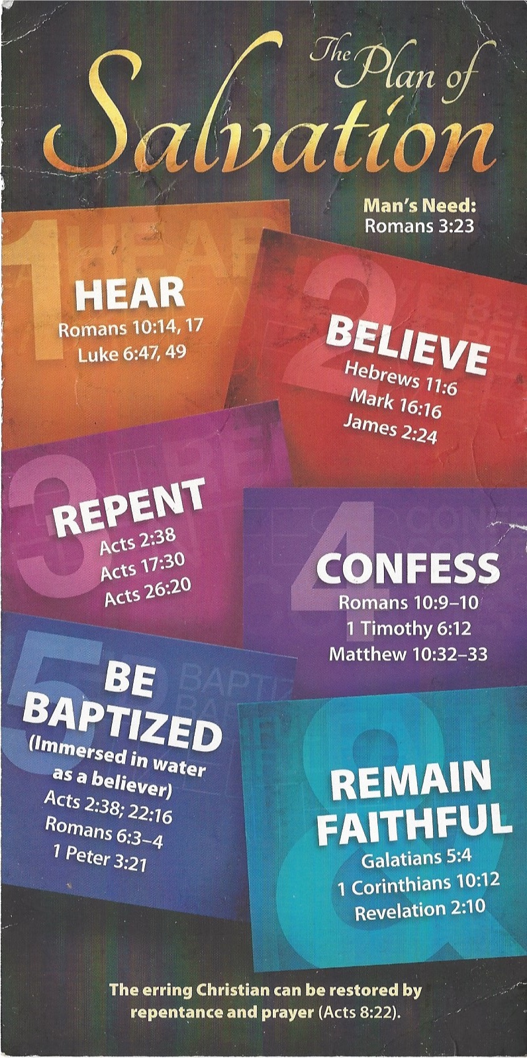
Hear
Romans 10:17 (KJV)
17 So then faith cometh by hearing, and hearing by the word of God.

Slide 29
Believe
Hebrews 11:6 (KJV)
6 But without faith it is impossible to please him: for he that cometh to God must believe that he is, and that he is a rewarder of them that diligently seek him

Slide 30
Repent
Acts 17:30 (KJV)
30 And the times of this ignorance God winked at; but now commandeth all men every where to repent:

Slide 31
Confess
1 Timothy 6:12 (KJV)
12 Fight the good fight of faith, lay hold on eternal life, whereunto thou art also called, and hast professed a good profession before many witnesses.

Slide 32
Be Baptized
Acts 22:16 (KJV)
16 And now why tarriest thou? arise, and be baptized, and wash away thy sins, calling on the name of the Lord.

Slide 33
Remain Faithful
1 Corinthians 10:12 (KJV)
12 Wherefore let him that thinketh he standeth take heed lest he fall.

